Slide 1
Intro to Machine Learning
Week 8 – Deep Learning

Slide 2
Today’s Agenda
What is deep learning?
What are neural networks and how do they work?
General applications of deep learning
Biomedical applications of deep learning
Challenges of deep learning in biomedical research
Deep learning vs classical machine learning

Slide 3
What is deep learning?
A family of machine learning methods focused on learning data representations, as opposed to task-specific algorithms.
Can be used for supervised or unsupervised learning.
Neural networks:
Artificial Neural Network (ANN)
Deep Neural Network (DNN)
Recurrent Neural Network (RNN)
Convolutional Neural Network (CNN)
Multilayer Perceptron (MLP)
Notes:
Each type of neural network is typically used for different purposes and just like any other machine learning model, has pros and cons.

Slide 4
What is deep learning?
Its…complicated
This class will provide a baseline summary of deep learning
But keep in mind, its impossible to understand deep learning and its complexities in just a short one hour class.
To fully understand it, we recommend looking for online courses outside of class.
As has been a theme in this course, we are going to stray away from the complex math and try to keep things simple
That being said, we have to cover some of the math in order to make sense of how neural networks work

Slide 5
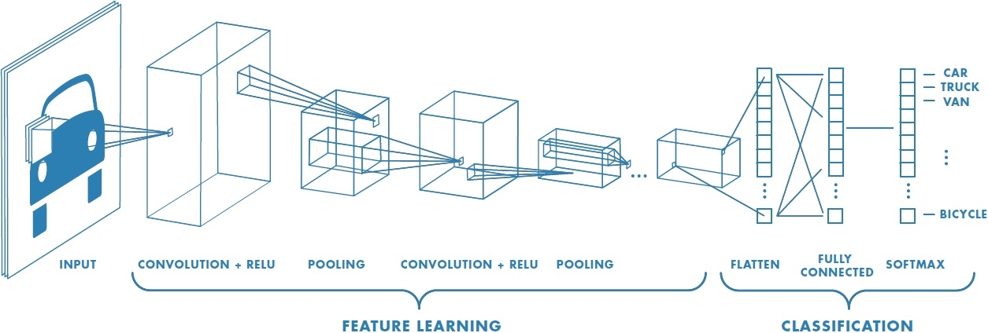
Deep Learning

Slide 6
What are neural Networks?
Set of algorithms, modeled loosely after the human brain, that are designed to recognize patterns.
They can help us cluster (unsupervised learning) or classify (supervised learning) data.
Neural network is made up by an interconnected web or nodes (neurons) and edges (connections).
Neural networks are just like other ML models, as they can be altered using parameters and are made more useful when running on clean data.

Slide 7
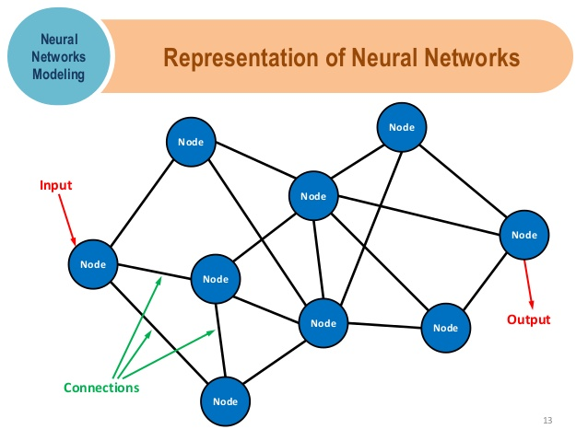
neural Networks

Slide 8
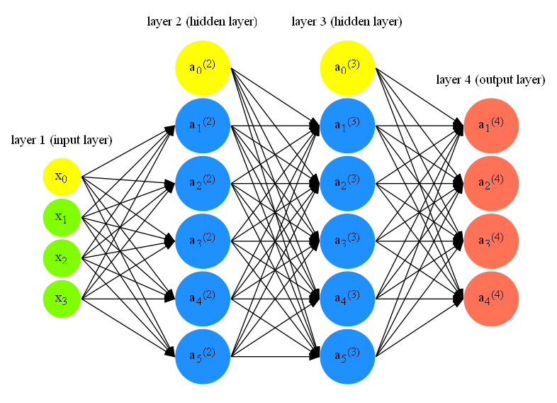
neural Networks
Notes:
Neural networks can be very complicated…

Slide 9
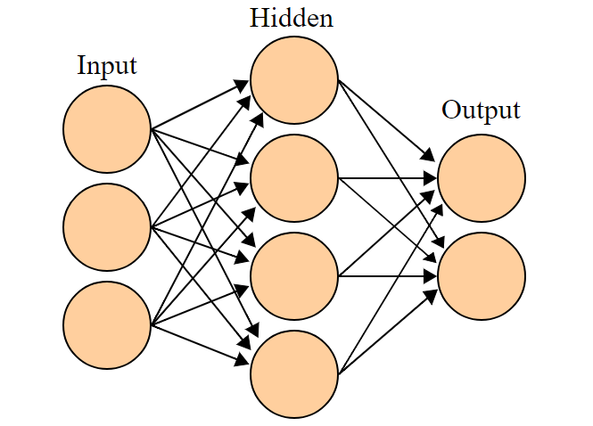
Neural Networks - Basic Structure
Neural networks are highly structured.
The web is made up of various Layers
The network will have only one input layer and one output layer but can have a high number of hidden layers.
The more hidden layers, the more complex the network, the more complex relationships can be detected.

Slide 10
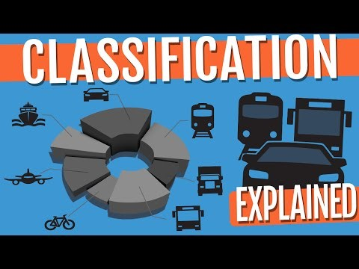
Neural Networks - Explained
Notes:
2:01 – 3:30
Note: this is a great video series on youtube you should definitely watch if you want to learn more

Slide 11
Neural Networks – Weights and Biases
Nodes do not activate or “fire” randomly
If a node in a hidden layer receives the exact same input twice, it will activate the exact same way each time.
Weights = unique value passed by output passed from one node to the nodes in the next layer (edge)
Bias = unique value used to calculate node value to be passed on to the next layer (node)
Bias values is not influenced by the values in the previous layer
It is a value that is added to the input values
For example, if a given node has zero input then it’s output value = its bias! (output = 0 + bias)

Slide 12
Neural Network – Steps (classification)
For each training sample:
Input values mapped to single 1-dimensional list or column of values
We apply weights and biases to our neurons.
Could be random, could also be non-random
Each input value, connected to each neuron in the first hidden layer (assumes simple ANN), is then used to calculate each hidden layer’s neuron’s “activation”.
Activation = the output value calculated at each neuron in a hidden layer that is then used as an input value for the next layer.
Each neuron uses an activation function to calculate the output value or activation to be passed to the next
Activation function = non-linear function needed to be applied to each neuron as the goal is to create a non-linear decision boundary via non-linear combinations of weights and inputs
Examples = ReLu, Sigmoid, Tahn unit (ReLu is the most common)
Notes:
ReLu = Rectified Linear Unit function

Slide 13
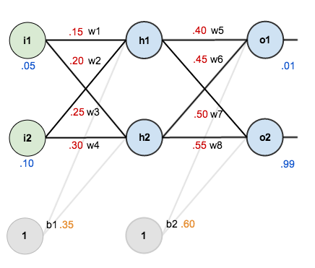
Neural Network – Steps
The forward propagation continues for each hidden layer until the eventual output values are created.
Now we look at our output layer, which represents our classes. The neuron with the highest value is our prediction.
In this example, the given inputs the network is being trained on (single observation) would be classified as o2 (output 2)
After training, use a cost function to determine how well the model is performing
Typically, this first run-through will be…pretty bad
Cost Function
Input = weights/biases
Output = cost (single number)
Parameters = lots of training examples
Notes:
ReLu = Rectified Linear Unit function

Slide 14
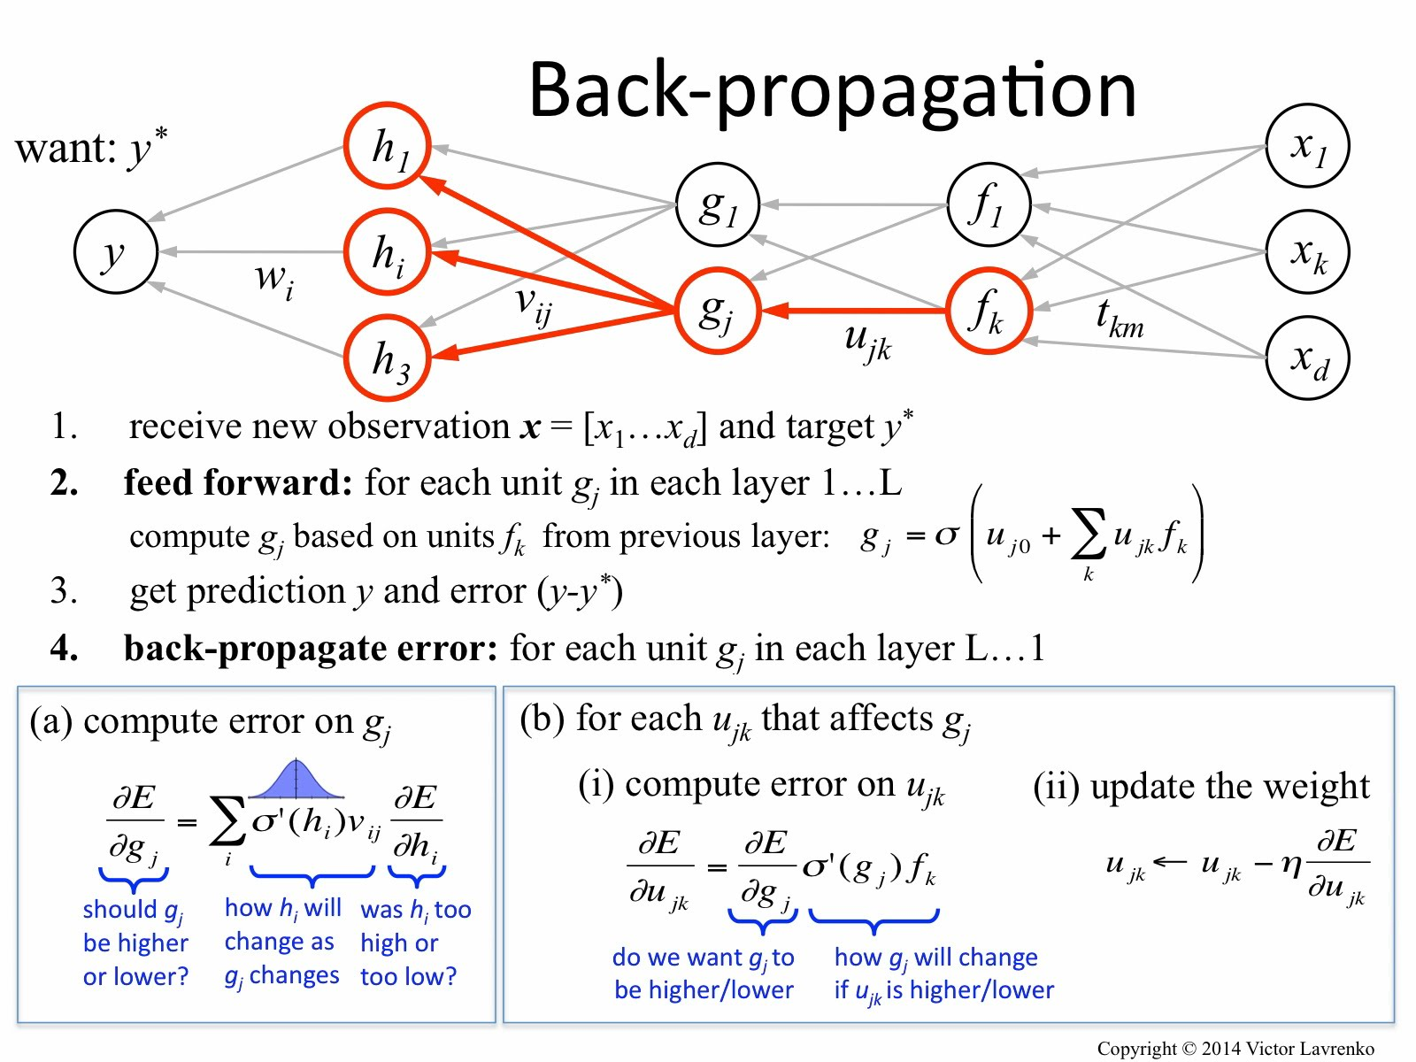
Neural Network – Steps
We try to find the local minimum of the cost function by adjusting the weights/biases of our network. (called backpropagation)
That means adjustments to each one of the weights and biases.
We adjust numerous times until we can’t minimize the cost function any more.

Slide 15
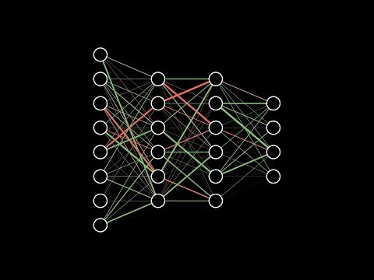
Neural Network – Steps
Notes:
2:15-16:20

Slide 16
Applications of Deep Learning
Classification
Image recognition
Voice recognition
Other more traditional classification tasks: spam in emails, fraudulent credit card transactions, sentiment analysis, etc.
Regression
Likelihood of hardware breakdowns in data centers, manufacturing, transportation
Likelihood of health problems (stroke, heart attacks based on vital status or data from wearables)
Clustering
Comparing/grouping images or sounds to similar other similar items

Slide 17
Applications of Deep Learning
Convolutional Neural Network (CNN)
Most common neural network architecture for image analysis and classification
Recurrent Neural Network (RNN)
Used in NLP, protein/DNA sequencing data, clinical data
Work well with sequential data
Autoencoder
Used for unsupervised learning, dimensionality reduction
Radial Basis Function (RBF) Networks
And many more…

Slide 18
Biomedical Applications of deep Learning
Biomedical domain commonly deals with complex high-dimensional data and images.
In computational biology:
High dimensional data includes DNA sequencing, RNA sequencing, flow cytometry, automated microscopy, etc.
Deep neural networks with multiple layers have been used to detect high level features, improve performance over traditional models, increase understanding about structure of biological data.
CNNs have been used in numerous image-related projects
Counting bacterial populations in agar plate images
Identifying tumor’s from MRI images
Protein microarray expression in images
Ideally, we want to see CNNs deployed more in biomedical research image analysis but there are some specific challenges
Notes:
“Deep” networks refer to neural networks with a high number of hidden layers.

Slide 19
Challenges of Deep learning in biomedical research
Data availability
Generating images can be very costly
Annotation requires high level of expertise
HIPPA privacy concerns, data sharing is challenging
Thus, data sets are typically small
Data formatting
High-resolution requirements often lead to using special image formats (DICOM, Nifty, Analyze, etc.)
Special formats typically not supported by deep learning frameworks, pre-trained models
Images often require metadata critical to interpretation (anatomical info, patient demographics)
Notes:
“Deep” networks refer to neural networks with a high number of hidden layers.

Slide 20
Challenges of Deep learning in biomedical research
Data dimensionality/size
Volumetric images (3D images like MRI, CT, PET)
Longitudinal images (organ function)
High-dimensional images often needed to detect clinically important features
Thus, large data sizes for each sample which leads to computational/memory constraints
Data properties
Small image features can have large clinical importance
Some image features are very rare but have high clinical importance
Leads to large class imbalances in our model
Thus, requires special loss functions and evaluation metrics
Notes:
“Deep” networks refer to neural networks with a high number of hidden layers.

Slide 21
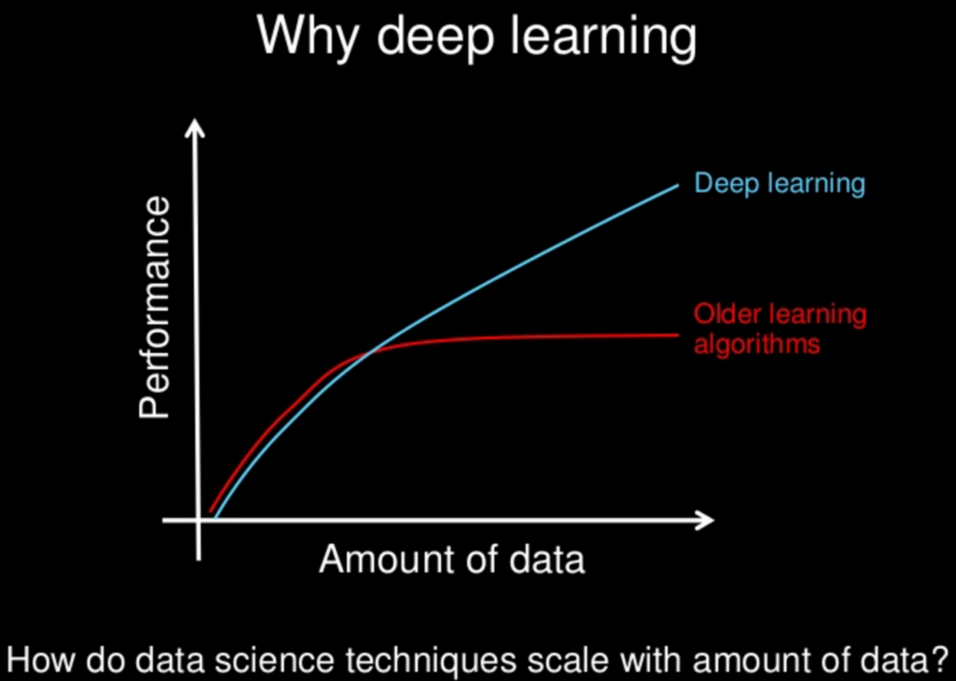
Deep learning > Classical ML
Why Deep Learning works better than classical ML:
Scales effectively with data
Sometimes all it takes to improve a deep learning model is to train on more data.
With classical ML it will typically require more than more data to increase performance.
No need for feature engineering
Classical ML often requires complex feature engineering (data exploration, dimensionality reduction, feature selection, etc.)
With deep learning you can simply pass the entire data directly to the network and achieve good performance.

Slide 22
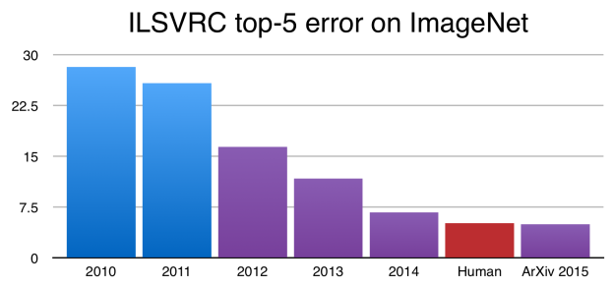
Deep learning > Classical ML
Adaptable and transferable
Deep learning can be adapted to different domains and applications far more easily that classical ML
Ability to use pre-trained networks on other applications within the same domain
Can even use pre-trained networks as inputs to another neural network
Best Performance
Deep networks have achieved much higher accuracy than the most complex classical ML models
Notes:
Pre-trained networks: used in image analysis/computer vision, genome sequencing, etc.
Graph: blue models are best classical ML image classifiers vs red (CNN) and purple are other types of neural nets

Slide 23
Classical ML > Deep Learning
Works better on small amounts of data
Achieving high performance with deep networks require extremely large datasets.
Pre-trained networks are typically trained on well over 1 million images…
Classical ML can perform relatively well without a reliance on a massive dataset
Financially and computationally cheap
Training a neural network requires high-end GPUs (graphics processing unit) to be trained in a reasonable amount of time with large amount of data. GPUs are expensive.
Easier to interpret
Deep learning often is a black box, hard to know how your network is truly behaving.
Notes:
Small data: the reason deep learning has flourished is due to us entering the “big data” era (customer data, images, medical data, etc.)

Slide 24
Deep Learning – Final thoughts
Use on very complex problems where performance is extremely important
The gold standard for image classification
Also the best method when working with large, high-dimensional data
Make sure you have the computational power necessary
Look up more! Its impossible to cover everything in one hour…

Slide 25
That’s it! Thank you For being a great class!
Notes:
Interest in a more in depth ml class in the future?

